Slide 1
Housekeeping:
We’re almost done! Things left and scheduling:
Exam – Dec 9. Theory and answering questions. No submission of code.
Hypothesis testing, estimates, regression/classification, data prep/exploration, etc…
Assignment 4 – Dec 2. One (larger) logistic regression problem.
Project – Dec 13. Open ended exploration and prediction.
In groups, so the work can be divided.
Take a look, we can discuss next time in more detail.
Quiz 3 – I’d probably cancel this (the school wants LOTS of small assignments), if you want to do it, I can open it up for you.
Today: More logistic regression and imbalanced data. (027)
Other remaining classes: Bayes and probability, time series basics, notes on CLT. (All not directly needed for pred. mod.)

Slide 2
Housekeeping
Today:
Classification.
Logistic regression.
Gradient descent.
Cost and loss.
Classification error intro.

Slide 3
Classification and Imbalanced Data

Slide 4
Classification
Classification is predicting if observations fall into one group or another.
For now, we’ll do only two groups – True/False.
E.g. will this person be a customer? Is this MRI cancer? Will this company go bankrupt?
Linear regression was possible to calculate directly – linear least squares.
Classification, using logistic regression, isn’t something where we can calculate the model from the data.
We need to use an iterative process to “train” the model.

Slide 5
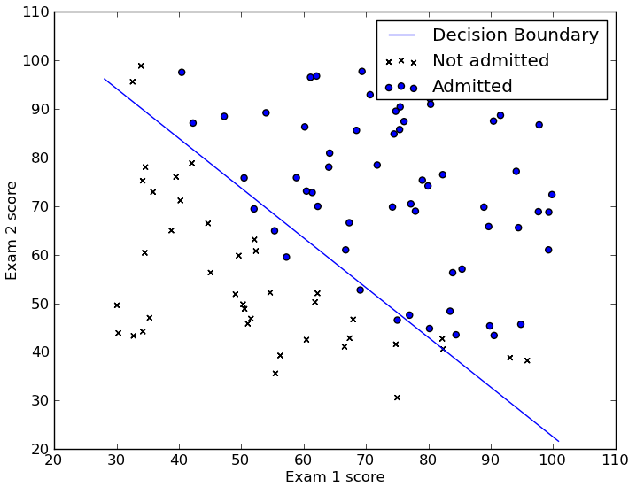
Classification and Logistic Regression
Logistic regression (and all classifiers) aim to split the data into two (or more) groups, called classes.
E.g. customer/not-customer, True/False, 1/0
We can visualize this with a dataset with 2 features.
E.g. Predict admission from two test scores.
The model here is the line, rather than being a best fit like a regression, it acts to separate class A from class B.
Logistic regression is a linear model, so we can only make a line to classify the data.
The line is our decision boundary.

Slide 6
Finding the Line – Descend that Gradient
In linear regression the “least squares” calculates m and b directly.
Our line (the model) that divides the two classes was generated by the gradient descent process we mentioned:
Make a prediction for the model’s values (2 slopes and intercept in this one).
Check the error with those values.
Use some calculus to attribute the errors to the original terms (y = m1*x1 + m2*x2 +…)
Adjust each term to get a bit less error.
When the error hits the lowest point, whatever the slope and intercept is at that point is the values we need for the model. Y = m1*x1 + m2*x2 + b
Just like linear regression, these values are all we need for a model (with more math).
Note: the error here is not accuracy of predictions, it is the distance between prediction percentage and reality.

Slide 7
Training Process
This inability to calculate an answer directly is common to most ML algorithms.
We instead need to let a model “train” or learn the answer bit by bit.
This is what happens during the “fit()” call.
The model is initialized as something that works, but poorly.
Each round the accuracy is improved a bit.
Eventually we have the best version we can get (or hit a limit).

Slide 10
Animation with Linear Regression

Slide 11
Cost/Loss
The key factor in doing the gradient descent is the error, or the cost.
The term loss is also common, technically loss means one run, cost is aggregate.
Loss and cost are commonly interchanged, and it doesn’t really matter in most cases.
The cost function calculates error, which tells the algorithm that it needs to adjust.
For regression problems, the cost is generally the MSE.
For classification problems, we don’t use the accuracy, we have a separate cost.
Accuracy is the end result, for users to look at.
Cost is measured based on the “closeness” of the model to the correct answer.
Allows for a much better fitted model.

Slide 12
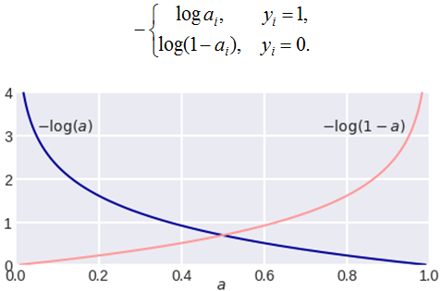
Cost Functions
Cost functions are the functions that calculate the… cost.
There are many different cost functions.
Binary (two class) classification usually uses Log-Loss, or Binary Cross Entropy.
Log-Loss basics:
Distance of the prediction of probability to the real answer. On a 0 to 1 scale.
Model predicts the probability of a 1, loss is distance to 0 if the real answer is 0, and distance to 1 if the real answer is 1.
Model learns to minimize the “distance” to correct.

Slide 13
More on Costs
Cost functions ca be defined to be almost anything.
Need to be differentiable – i.e. we can calculate the derivative.
In practice most are easily differentiable, for speed. Hence few absolute value.
E.g. a “Price is Right” model predicting if you should bet might have a different cost for ”too low” (not high enough) vs ”too high” (instant loss) in its cost calculations.
The cost is (normally, in classification) an internal metric to the algorithm.
The model is made by minimizing the cost.
The cost isn’t really a ”user facing” metric that we’d look at when using the model.
We normally look at an accuracy-based metric to judge a model – that’s separate.

Slide 14
Gradient Descent
This gradient descent process is one that is very common, not just for logistic regression.
When we can’t directly calculate the “answers” like we can in linear regression, we do something like this – repeated guess and test as we progress towards the answer.
The starting values don’t really matter for the end result.
Different algorithms have different methods (sometimes controllable by an argument) that generate a starting point of values (slopes and an intercept).
The starting guess is intended to reduce the rounds needed to find the answer.
This is mainly relevant for efficiency – when processing large amounts of data, saving rounds of calculation can really add up.

Slide 15
Gradient Descent in Practice
In real usage, gradient descent is everywhere.
As long as the cost can be calculated (and differentiated), and we have weights to adjust.
Most linear regression models use gradient descent rather than direct calculation.
Neural networks do lots of gradient descent, that’s why they take a long time to train.
Rather than a handful of weights, they can have hundreds of billions.
Many other algorithms (like SVM) use gradient descent at some stage.
There are gradient descent “adjustments” that can help make better models.
We’ll look at this soon-ish.
Reduce overfitting, improve speed, select features.

Slide 16
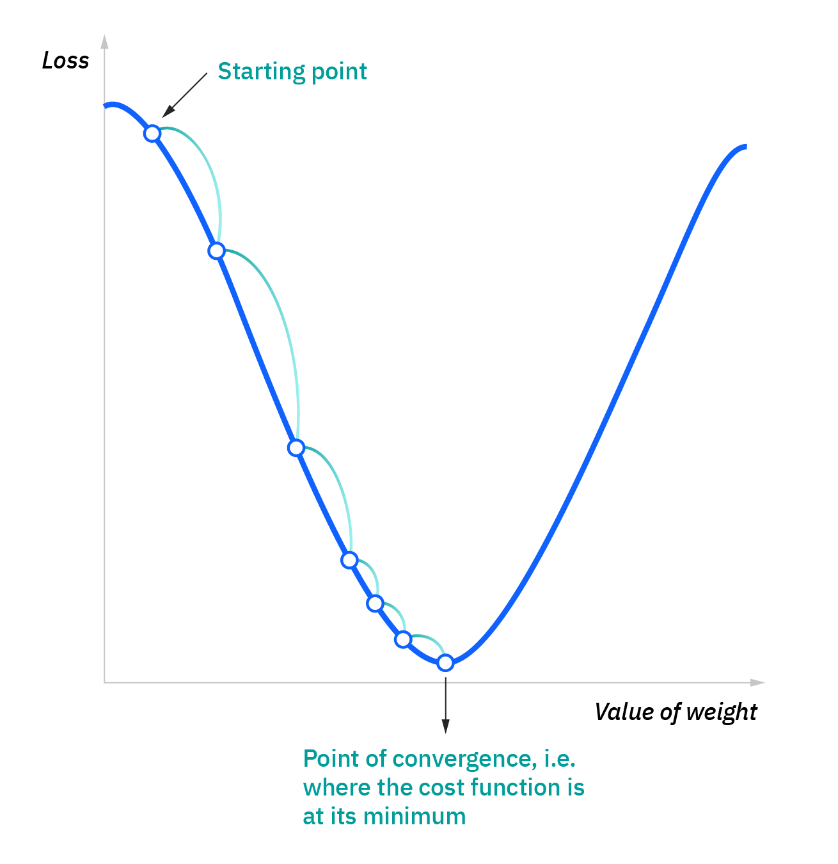

Slide 17
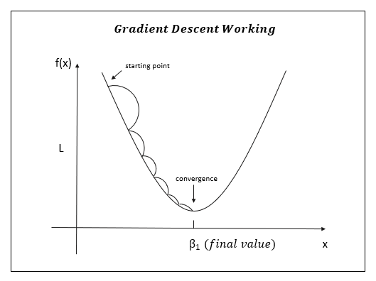

Slide 18
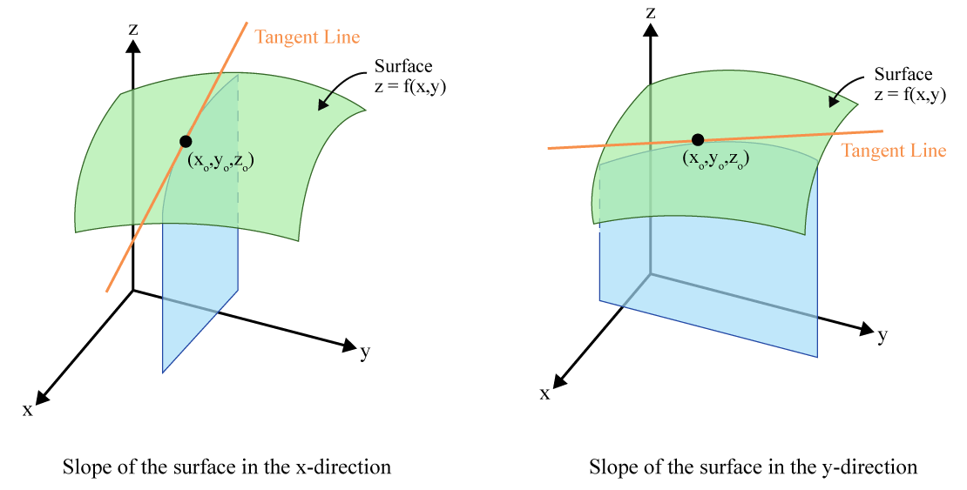


Slide 19
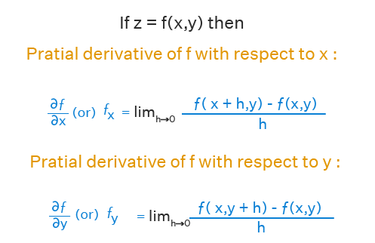
Ignore Calcs if Gibberish
When there is more than one X value (feature).
The slope of each weight is calculated on its own.
Each slope is the derivative with respect to X_{i}
I.e. direction to change that X to lower cost.
“Chain Rule” is the tool in math.
This effectively “attributes” the error to each X.
Total cost is split amongst X according to results.
Each is adjusted proportionately to lower error.
The model can learn each X separately to fit better to the data. (More X, more capacity).

Slide 20
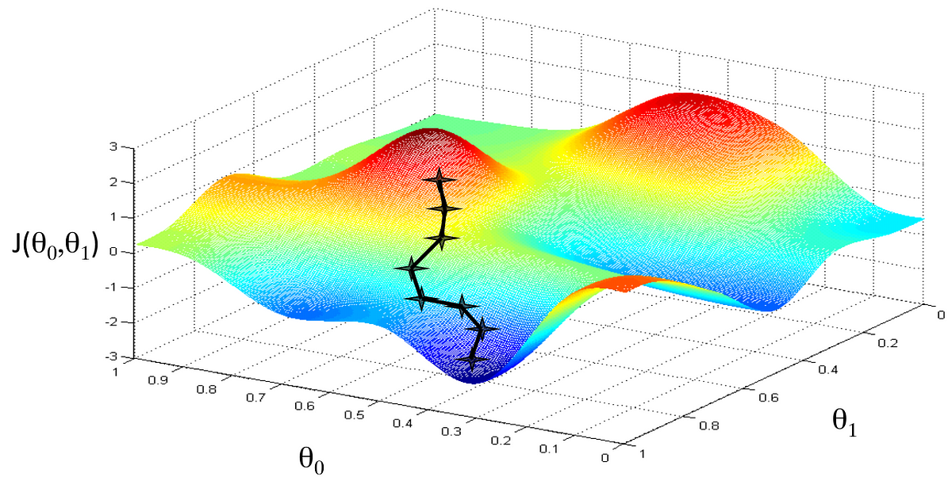

Slide 21
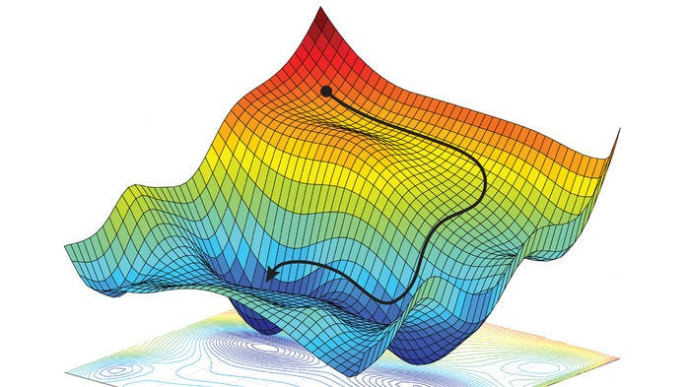

Slide 22
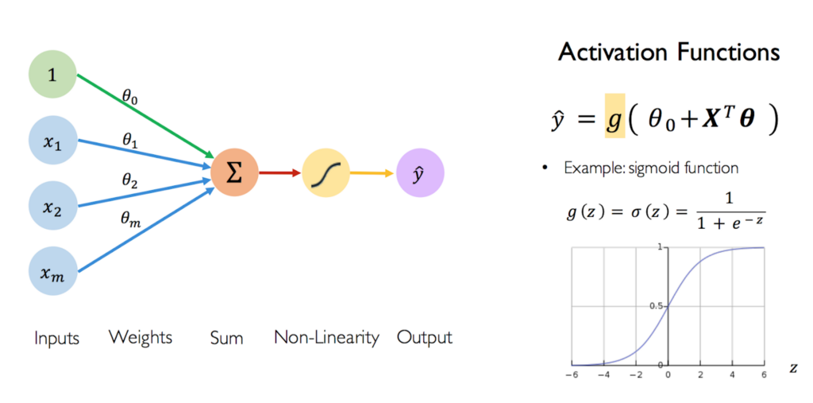

Slide 23
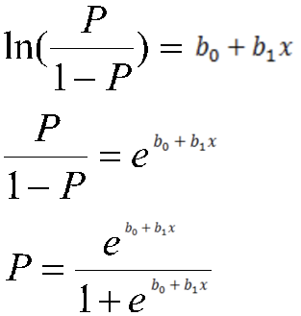
Gradient Descent Results
Eventually we have a model.
The model is just like a linear regression, we only need the weights (coefficients) to generate a model.
The gradient descent calculates each weight for us, incrementally.
The model doesn’t predict an answer, it predicts the log-odds. We can then use the sigmoid to translate to probability, and a cutoff to generate an actual answer.
We don’t calculate an answer, we wait until the “wrongness” of our current guess can’t be reduced.

Slide 24
Errors

Slide 25
Model Accuracy
The cost doesn’t directly tell us accuracy of the final model.
In regression cost and “user facing” accuracy are the same.
In classification, the accuracy and cost answer different questions.
There are several different measures for classification accuracy.
The most basic is accuracy - #correct / #total N.
Several other accuracy measures can be useful or needed.
Accuracy can be examined by looking at a confusion matrix.

Slide 26
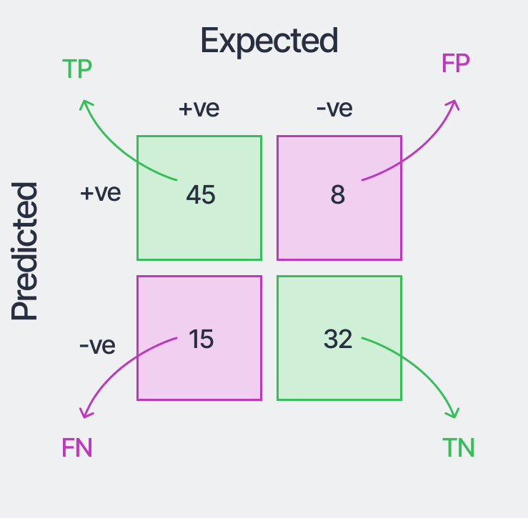
Confusion Matrix
A confusion matrix shows the “types” of right and wrong predictions from the model.
We can have two types of errors:
Type 1: Predicting 1 when it is really 0.
Type 2: Predicting 0 when it is really 1.
These impact accuracy the same, but might not have the same impact.
E.g. detecting credit card fraud… we could miss all fraud and have 99.9+% accuracy.
Confusion matrix allows us to spot balance.

Slide 27
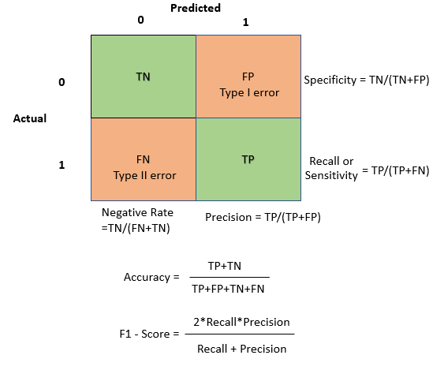
Derived Accuracies
We can use the results in a confusion matrix to calculate other error metrics.
Precision – what share of predicted 1s are right?
Where we don’t want T2 errors. FP > FN.
Targeted ads, spam detection, etc…
Recall – what share of actual1s did I predict?
Where we don’t want T1 errors. FN > FP.
Cancer prediction, safety thresholds, etc…
F1 – “Harmonic Mean” - derived to strike a balance.
Will perform poorly if either of the above is bad.

Slide 28
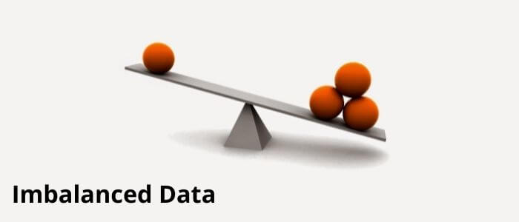

Slide 29
Imbalanced Data
On common issue with classification is that it is possible to have radically different number of samples in each of the classes.
E.g. credit card fraud – most things are not fraud.
This imbalance can present an issue, as our models generally want to be as accurate as possible.
If you predict False for every credit card transaction, you’ll miss all the fraud, but you’ll score north of 99.5% accuracy. Frauds can be disregarded in pursuit of accuracy.
Each gradient descent loop looks to make the predictions more accurate, if the data is imbalanced, we can be “pulled” in that direction. The majority class “dominates”.
In a credit card example, we may get lots of false negatives. Many frauds are missed.
One method to combat this is to look at other error metrics like recall, precision, and F1...

Slide 30
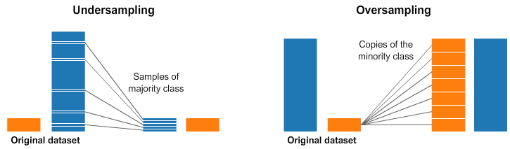
Data Resampling
Another thing we can do is manipulate the data, to make it less imbalanced.
We change the training dataset to be less “true to life” but to be better at “training a model”.
Analogous to if you studied for a diploma exam by looking at test prep material rather than the class material. You aren’t studying the “real” stuff, but you are using something that will prepare you better for what you care about – test performance. Or test data performance.
There are two basic approaches to this:
Undersampling – reducing the amount of the majority class.
Oversampling – increasing the amount of the minority class.

Slide 31
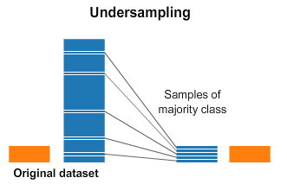
Undersampling
An undersample takes only some sample of the majority class, so there is more balance.
Most simple way is to just randomly select X records from the majority class.
Other algorithms use smarts to determine which to remove.
Tomek pairs, in the code example, removes some of the majority records that are “closest” to the decision boundary.

Slide 32

Oversampling
Oversampling is to reproduce the minority class records multiple times to improve the balance.
Most simple way is to just include the minority data multiple times.
i.e. random oversampling with replacement.
Smarter algorithms can generate “similar” data based on what is in the minority class.
SMOTE in the code example, creates interpolated (between) data records from the original.

Slide 33
Imbalanced Learning
We have a package that can handle most of the imbalanced stuff for us – imblearn.
This package provides functions that can do the resampling, that are in the same format as the sklearn stuff:
Using them is easy, as they perform like things we are used to.
We can incorporate them into things like pipelines, to make it easy.
Imblearn has lots of resampling algorithms that we can try.
Some are combined – eg. Oversample to generate new data, then under sample to “clean” it.
You likely don’t have imblearn installed.
Try running a code cell with “!pip install imblearn” and it will install it. (if you have pip)
“!conda install imblearn” (and “!conda install pip”) should do it if you don’t.

Slide 34
Process and Results
Having a more balanced dataset will generally help build better models.
Effects are not very predictable in most cases, must try and see results.
When oversampling we are inventing new data, that can introduce error.
When undersampling data we are removing data, that can introduce error.
When dealing with imbalanced data, we can include this in our prep steps:
E.g. clean data, remove outliers, select features, encode categorical, resample data, rescale data, etc….
We are focusing on the end result here – we are going to see if changing the dataset gives us a better model.

